Slide 1
S2-19_DSECLZC415 Data Exploration
Slide Courtesy: Prof. T.V. Rao

Slide 2

The slides presented here are obtained from the authors of the books and from various other contributors. I hereby acknowledge all the contributors for their material and inputs.
I have added and modified a few slides to suit the requirements of the course.

Slide 3
Agenda
Data objects and Attributes types
Basic Statistical Descriptions of Data
Measuring Data Similarity and Dissimilarity

Slide 4
Data Description

Slide 5
Types of Data Sets
Record
Relational records
Data matrix, e.g., numerical matrix, crosstabs
Document data: text documents: term-frequency vector
Transaction data
Graph and network
World Wide Web
Social or information networks
Molecular Structures
Ordered
Video data: sequence of images
Temporal data: time-series
Sequential Data: transaction sequences
Genetic sequence data
Spatial, image and multimedia:
Spatial data: maps
Image data:
Video data:

Slide 6
Important Characteristics of Structured Data
Dimensionality
Curse of dimensionality
Sparsity
Only presence counts
Resolution
Patterns depend on the scale
Distribution
Centrality and dispersion

Slide 7
Data Objects
Data sets are made up of data objects.
A data object represents an entity.
Examples:
sales database: customers, store items, sales
medical database: patients, treatments
university database: students, professors, courses
Also called samples , examples, instances, data points, objects, tuples.
Data objects are described by attributes.
Database rows -> data objects; columns ->attributes.

Slide 8
Attributes
Attribute (or dimensions, features, variables): a data field, representing a characteristic or feature of a data object.
E.g., customer _ID, name, address
Types:
Nominal
Binary
Numeric: quantitative
Interval-scaled
Ratio-scaled

Slide 9
Attribute Types
Nominal: categories, states, or “names of things”
Hair_color = {auburn, black, blond, brown, grey, red, white}
marital status, occupation, ID numbers, zip codes
Binary
Nominal attribute with only 2 states (0 and 1)
Symmetric binary: both outcomes equally important
e.g., gender
Asymmetric binary: outcomes not equally important.
e.g., medical test (positive vs. negative)
Convention: assign 1 to most important outcome (e.g., HIV positive)
Ordinal
Values have a meaningful order (ranking) but magnitude between successive values is not known.
Size = {small, medium, large}, grades, army rankings

Slide 10
Numeric Attribute Types
Quantity (integer or real-valued)
Interval
Measured on a scale of equal-sized units
Values have order
E.g., temperature in C˚or F˚, calendar dates
No true zero-point
Ratio
Inherent zero-point
We can speak of values as being an order of magnitude larger than the unit of measurement (10 K˚ is twice as high as 5 K˚).
e.g., temperature in Kelvin, length, counts, monetary quantities

Slide 11
Discrete vs. Continuous Attributes
Discrete Attribute
Has only a finite or countably infinite set of values
E.g., zip codes, profession, or the set of words in a collection of documents
Sometimes, represented as integer variables
Note: Binary attributes are a special case of discrete attributes
Continuous Attribute
Has real numbers as attribute values
E.g., temperature, height, or weight
Practically, real values can only be measured and represented using a finite number of digits
Continuous attributes are typically represented as floating-point variables

Slide 12
Basic Statistical Descriptions of Data
Motivation
To better understand the data: central tendency, variation and spread
Data dispersion characteristics
median, max, min, quantiles, outliers, variance, etc.
Numerical dimensions correspond to sorted intervals
Data dispersion: analyzed with multiple granularities of precision
Boxplot or quantile analysis on sorted intervals
Dispersion analysis on computed measures
Folding measures into numerical dimensions
Boxplot or quantile analysis on the transformed cube
Notes:
Note to self (MK): last part of slide does not clearly match slides that follow
Introduction slides:
In the current version, we only talk about numeric data. Can we add some materials about non-numeric data.
- text statistics, TF/IDF
- visualization of text statistics such as word cloud
- distribution of Internet (IN, SCC, OUT, …)
- visualization of social relationship (e.g., http://renlifang.msra.cn/)

Slide 13
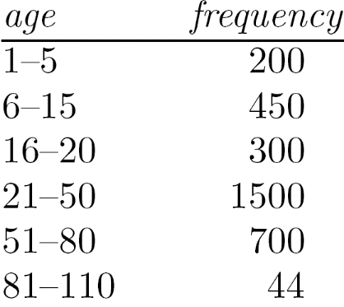
Measuring the Central Tendency
Mean (algebraic measure) (sample vs. population):
Note: n is sample size and N is population size.
Weighted arithmetic mean:
Trimmed mean: chopping extreme values
Median:
Middle value if odd number of values, or average of the middle two values otherwise
Estimated by interpolation (for grouped data):
Mode
Value that occurs most frequently in the data
Unimodal, bimodal, trimodal
Empirical formula:
Median interval

Slide 14
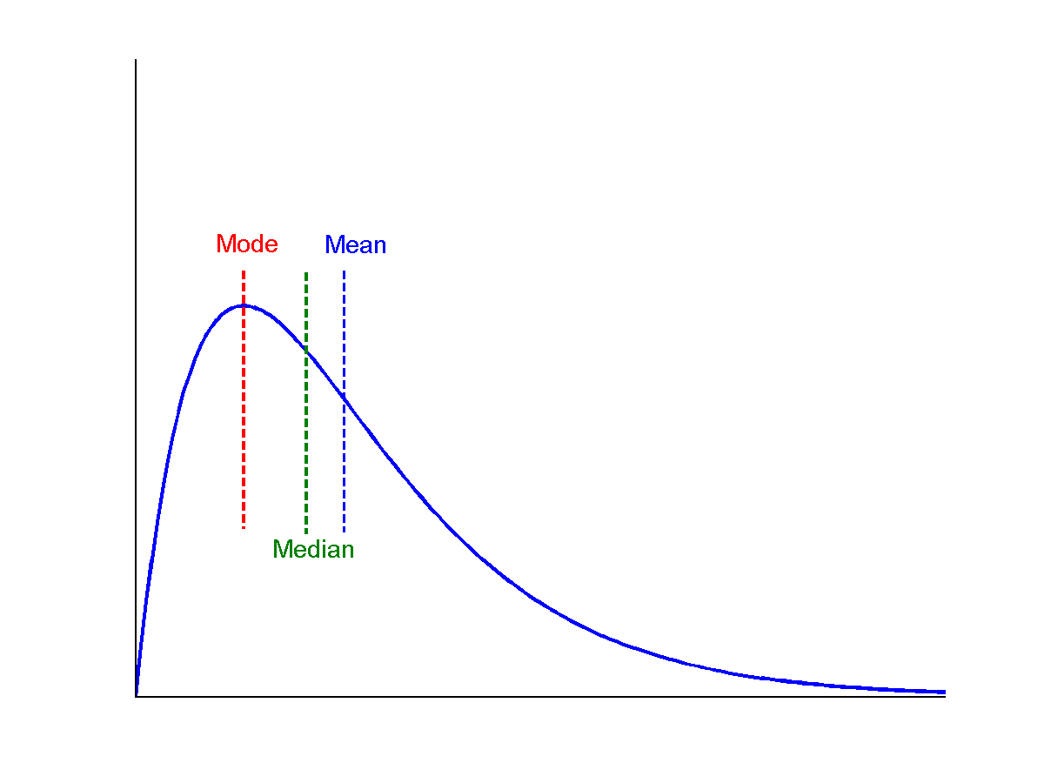
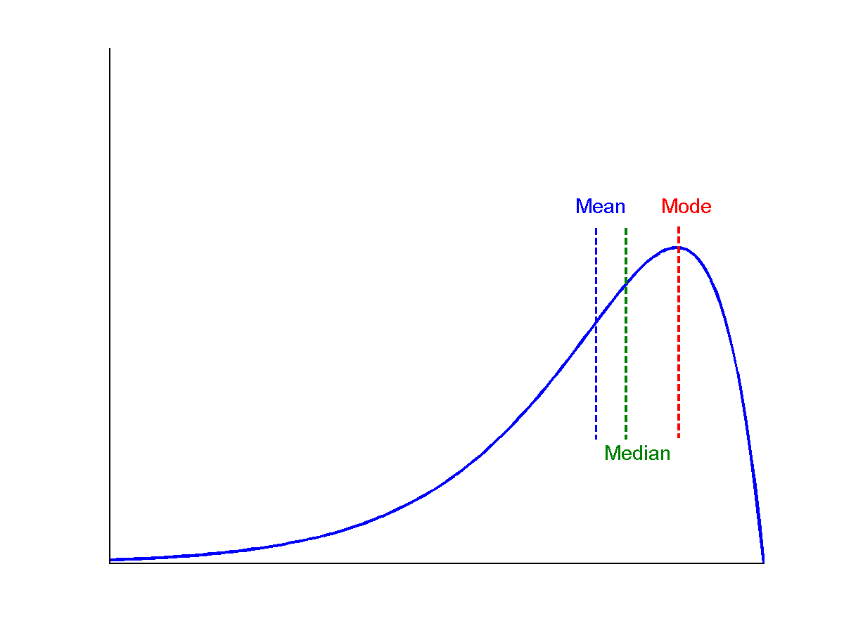
Symmetric vs. Skewed Data
Median, mean and mode of symmetric, positively and negatively skewed data
symmetric
negatively skewed
positively skewed

Slide 15
Measuring the Dispersion of Data
Quartiles, outliers and boxplots
Quartiles: Q₁ (25th percentile), Q₃ (75th percentile)
Inter-quartile range: IQR = Q₃ – Q₁
Five number summary: min, Q₁, median, Q₃, max
Boxplot: ends of the box are the quartiles; median is marked; add whiskers, and plot outliers individually
Outlier: usually, a value higher/lower than 1.5 x IQR
Variance and standard deviation (sample: s, population: σ)
Variance: (algebraic, scalable computation)
Standard deviation s (or σ) is the square root of variance s² ⁽or σ²⁾

Slide 16
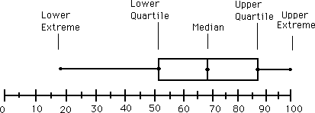
Boxplot Analysis
Five-number summary of a distribution
Minimum, Q1, Median, Q3, Maximum
Boxplot
Data is represented with a box
The ends of the box are at the first and third quartiles, i.e., the height of the box is IQR
The median is marked by a line within the box
Whiskers: two lines outside the box extended to Minimum and Maximum
Outliers: points beyond a specified outlier threshold, plotted individually
Notes:
Redraw the boxplot! Yes, we need a more real boxplot graph!

Slide 17
Example
Following is an ordered list of observations of a variable. Compute 5 point summary.
13, 15, 16, 16, 19, 20, 20, 21, 22, 22, 25, 25, 25, 25, 30, 33, 33, 35, 35, 35, 35, 36, 40, 45, 46, 52, 70
Solution:
Min: 13
Q1: 20
Median: 25
Q3: 35
Max: 70

Slide 18
Data Similarity/Dissimilarity

Slide 19
Similarity and Dissimilarity
Similarity
Numerical measure of how alike two data objects are
Value is higher when objects are more alike
Often falls in the range [0,1]
Dissimilarity (e.g., distance)
Numerical measure of how different two data objects are
Lower when objects are more alike
Minimum dissimilarity is often 0
Upper limit varies
Proximity refers to a similarity or dissimilarity

Slide 20
Data Matrix and Dissimilarity Matrix
Data matrix
n data points with p dimensions
Two modes
Dissimilarity matrix
n data points, but registers only the distance
A triangular matrix
Single mode

Slide 21
Proximity Measure for Nominal Attributes
Can take 2 or more states, e.g., red, yellow, blue, green (generalization of a binary attribute)
Method 1: Simple matching
m: # of matches, p: total # of variables
Method 2: Use a large number of binary attributes
creating a new binary attribute for each of the M nominal states

Slide 22
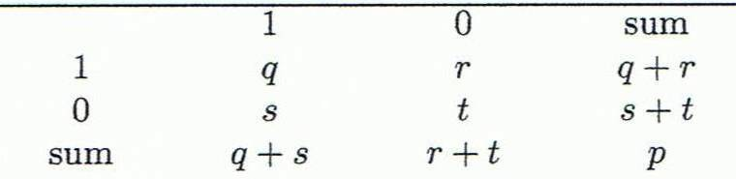
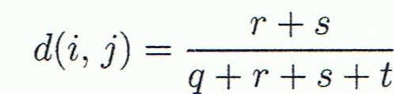
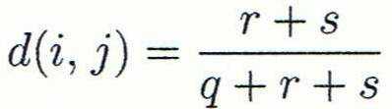

Proximity Measure for Binary Attributes
Object j
A contingency table for binary data
Distance measure for symmetric binary variables:
Distance measure for asymmetric binary variables:
Jaccard coefficient (similarity measure for asymmetric binary variables):
Object i
Note: Jaccard coefficient is the same as “coherence”:
Notes:
MK: I tried to change equations so as to match notation in book, but each time I try to install the equation editor, it fails! Agh!

Slide 23
Dissimilarity between Binary Variables
Example
Gender is a symmetric attribute
The remaining attributes are asymmetric binary
Let the values Y and P be 1, and the value N 0

Slide 24
Standardizing Numeric Data
Z-score:
X: raw score to be standardized, μ: mean of the population, σ: standard deviation
the distance between the raw score and the population mean in units of the standard deviation
negative when the raw score is below the mean, “+” when above
An alternative way: Calculate the mean absolute deviation
where
standardized measure (z-score):
Using mean absolute deviation is more robust than using standard deviation

Slide 25
Example: Data Matrix and Dissimilarity Matrix
Data Matrix
Dissimilarity Matrix
(with Euclidean Distance)

Slide 26
Distance on Numeric Data: Minkowski Distance
Minkowski distance: A popular distance measure
where i = (x_{i1}, x_{i2}, …, x_{ip}) and j = (x_{j1}, x_{j2}, …, x_{jp}) are two p-dimensional data objects, and h is the order (the distance so defined is also called L-h norm)
Properties
d(i, j) > 0 if i ≠ j, and d(i, i) = 0 (Positive definiteness)
d(i, j) = d(j, i) (Symmetry)
d(i, j) ≤ d(i, k) + d(k, j) (Triangle Inequality)
A distance that satisfies these properties is a metric

Slide 27
Special Cases of Minkowski Distance
h = 1: Manhattan (city block, L₁ norm) distance
E.g., the Hamming distance: the number of bits that are different between two binary vectors
h = 2: (L₂ norm) Euclidean distance
h → ∞. “supremum” (L_{max} norm, L∞ norm) distance.
This is the maximum difference between any component (attribute) of the vectors

Slide 28
Example: Minkowski Distance
(Dissimilarity Matrices)
Manhattan (L₁)
Euclidean (L₂)
Supremum

Slide 29
Ordinal Variables
An ordinal variable can be discrete or continuous
Order is important, e.g., rank
Can be treated like interval-scaled
replace x_{if} by their rank
map the range of each variable onto [0, 1] by replacing i-th object in the f-th variable by
compute the dissimilarity using methods for interval-scaled variables

Slide 30
Attributes of Mixed Type
A database may contain all attribute types
Nominal, symmetric binary, asymmetric binary, numeric, ordinal
One may use a weighted formula to combine their effects
f is binary or nominal:
d_{ij}^{(f)} = 0 if x_{if} = x_{jf} , or d_{ij}^{(f)} = 1 otherwise
f is numeric: use the normalized distance
f is ordinal
Compute ranks r_{if} and
Treat z_{if} as interval-scaled

Slide 31
Example
Based on the information given in the table below, find most similar and most dissimilar persons among them. Apply min-max normalization on income to obtain [0,1] range. Consider profession and mother tongue as nominal. Consider native place as ordinal variable with ranking order of [Village, Small Town, Suburban, Metropolitan]. Give equal weight to each attribute.
Name | Income | Profession | Mother tongue | Native Place
Ram | 70000 | Doctor | Bengali | Village
Balram | 50000 | Data Scientist | Hindi | Small Town
Bharat | 60000 | Carpenter | Hindi | Suburban
Kishan | 80000 | Doctor | Bhojpuri | Metropolitan

Slide 32
Solution
After normalizing income and quantifying native place, we get
d(Ram, Balram) = 0.67+1+1+(2-1)/(4-1)=3 d(Ram, Bharat) = 0.33+1+1+(3-1)/(4-1)=3
d(Ram, Kishan) = 0.33+0+1+(4-1)/(4-1) = 2.33 d(Balram, Bharat) = 0.33+1+0+(3-2)/(4-1)=1.67
d(Balram, Kishan) = 1+1+1+(4-2)/(4-1) = 3.67 d(Bharat, Kishan) = 0.67+1+1+(4-3)/(4-1) = 3
Most similar – Balram and Bharat; Most dissimilar – Balram and Kishan
Name | Income | Profession | Mother tongue | Native Place
Ram | 0.67 | Doctor | Bengali | 1
Balram | 0 | Data Scientist | Hindi | 2
Bharat | 0.33 | Carpenter | Hindi | 3
Kishan | 1 | Doctor | Bhojpuri | 4

Slide 33
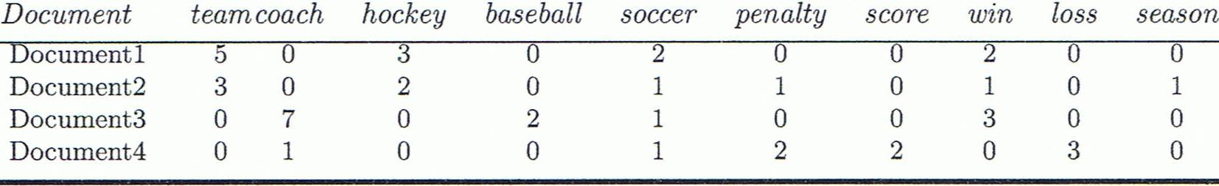
Cosine Similarity
A document can be represented by thousands of attributes, each recording the frequency of a particular word (such as keywords) or phrase in the document.
Other vector objects: gene features in micro-arrays, …
Applications: information retrieval, biologic taxonomy, gene feature mapping, ...
Cosine measure: If d₁ and d₂ are two vectors (e.g., term-frequency vectors), then
cos(d₁, d₂) = (d₁ • d₂) /||d₁|| ||d₂|| ,
where • indicates vector dot product, ||d||: the length of vector d

Slide 34
Example: Cosine Similarity
cos(d₁, d₂) = (d₁ • d₂) /||d₁|| ||d₂|| ,
where • indicates vector dot product, ||d|: the length of vector d
Ex: Find the similarity between documents 1 and 2.
d₁ = (5, 0, 3, 0, 2, 0, 0, 2, 0, 0)
d₂ = (3, 0, 2, 0, 1, 1, 0, 1, 0, 1)
d₁•d₂ = 5*3+0*0+3*2+0*0+2*1+0*1+0*1+2*1+0*0+0*1 = 25
||d₁||= (5*5+0*0+3*3+0*0+2*2+0*0+0*0+2*2+0*0+0*0)^{0.5}=(42)^{0.5} = 6.481
||d₂||= (3*3+0*0+2*2+0*0+1*1+1*1+0*0+1*1+0*0+1*1)^{0.5}=(17)^{0.5} = 4.12
cos(d₁, d₂ ) = 0.94
Notes:
09/09/25MK: New example (previous one was from Tan’s book).
Chapter 3: Statistics Methods
Co-variance distance
K-L divergence

Slide 35
Thank You

